Slide 1
Optimal Radiometric Calibration for Camera-Display Communication
Eric Wengrowski, Wenjia Yuan, Ashwin Ashok, Kristin Dana, Marco Gruteser, Narayan Mandayam

Slide 2
Ordinary Images Displayed On-Screen…

Slide 3
Contain Hidden, Dynamic, Camera-Readable Messages

Slide 4
Add Spatial-Temporal Intensity Changes

Slide 5
Camera-Display Transfer Function (CDTF)
Noise From:
Radiometric Response
Light Field in Free Space
Camera Sensitivity Function
Display Emittance Function

Slide 6
Dual Problem: Invisibility and Robustness
Low Intensity Message
Low Visibility
Erroneous Camera Recovery
High Intensity Message
High Visibility
Robust Camera Recovery
Message Intensity = 3/255
Message Intensity = 20/255

Slide 8
Solution: Online Calibration

Slide 9
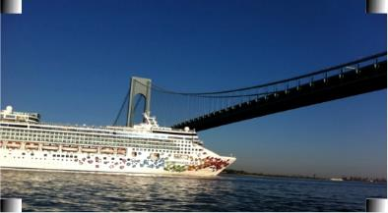
Calibration Patches used to estimate CDTF
4th order polynomial
Apply inverse of our polynomial estimate to negate errors
But Ugly!
Artifacts on image

Slide 10
Alternative: Histogram Equalization

Slide 11
Evaluation and Results
Tested 9 combinations of Cameras and Displays
Greatly improves low-intensity, highly oblique messaging
Message Intensity = 3/255
Camera-Display Angle = 45°

Slide 12
Review
2 Online Calibration Algorithms
Ratex Patches:
~99% accuracy
Visually obtrusive
Hidden Ratex
~90% accuracy
Visually unobtrusive
Online Algorithm: No prior hardware or pose info
No specialized cameras/displays needed
Applicable to virtually any hidden messaging scheme

Slide 13
Thank you

